Slide 1


Principles of Information Security,
Fifth Edition
Chapter 1
Introduction to Information Security
Do not figure on opponents not attacking; worry about your own lack of preparation. BOOK OF THE FIVE RINGS

Slide 2




SOMETHING ABOUT ME
I’m Hafiz Muhammad Attaullah
MS (NED UET), Executive Education (Stanford),
Lecturer (CS) and Head of FYP, Faculty of Computing, MAJU
InfoSec Product Builder, NANOTECHX (Microsoft Imagine Cup Winner)
xCyber Security Consultant at GreensFin (Meezan Bank’s FinTech)
Community Manager, Cisco Community Pakistan
Cisco & Microsoft Certified Official Trainer
OSCP Certified
5x Microsoft Certified
2x Cisco Certified
2x IBM Certified
2x Aviatrix Certified (Multi-cloud)
Muhammad.attaullah@jinnah.edu
https://attaullah.com.pk/
@HafizMuhammadAttaullah

Slide 3
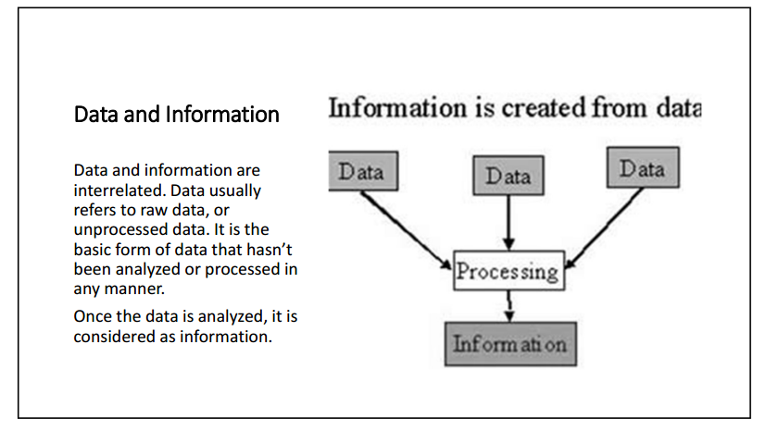

Slide 4
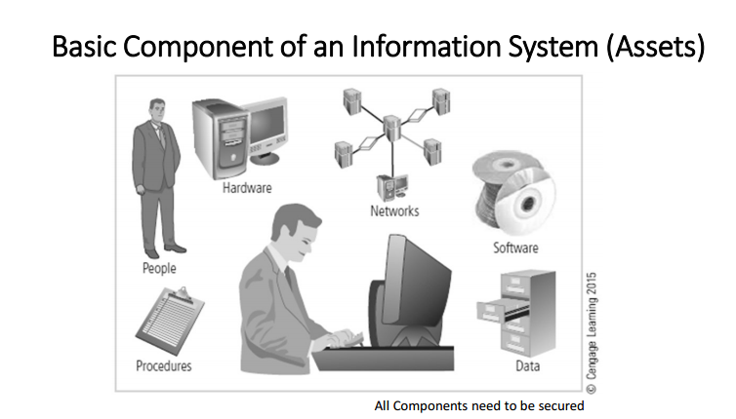

Slide 5
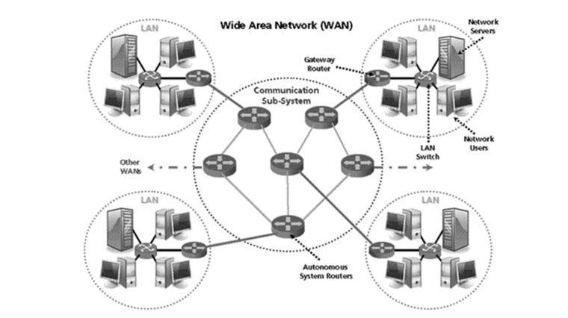
Network

Slide 6
What Is Security?

Slide 7
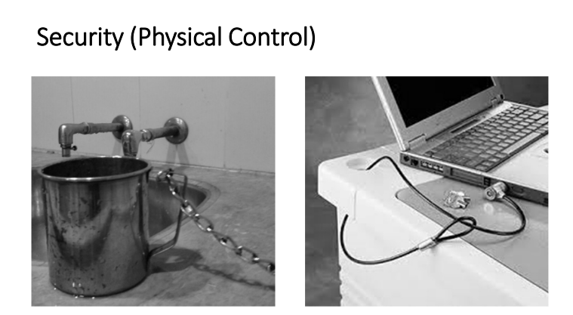

Slide 8
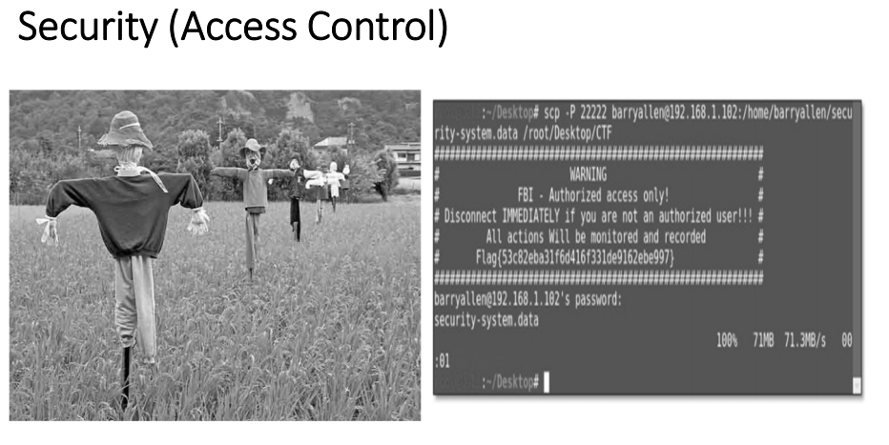

Slide 9
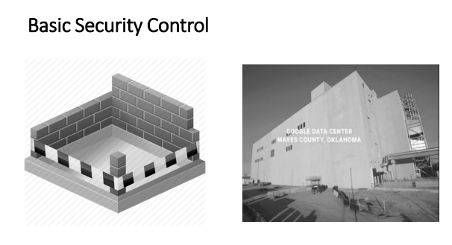

Slide 10
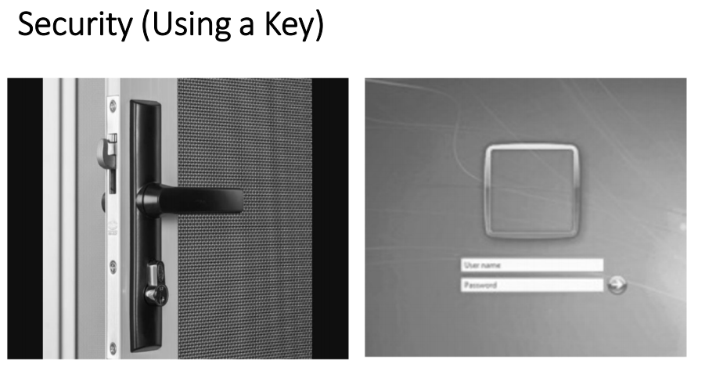

Slide 11
What Is Security?
• “A state of being secure and free from danger or harm; the actions taken to make someone or something secure.”
• A successful organization should have multiple layers of security in place to protect:
- Operations
- Physical infrastructure
- People
- Functions
- Communications
Information
Principles of Information Security, Fifth Edition
5

Slide 12
What Is Security? (cont’d)
• The protection of information and its critical elements, including systems and hardware that use, store and transmit that information
• Includes information security management, data security and network security
Principles of Information Security, Fifth Edition
6

Slide 13
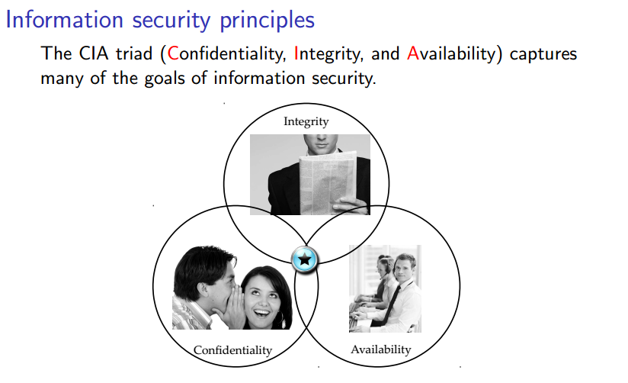

Slide 14
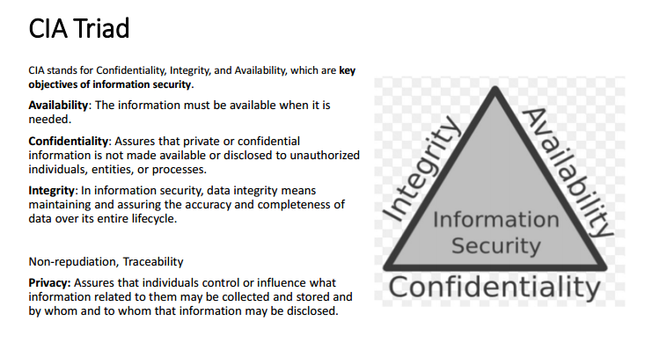

Slide 15
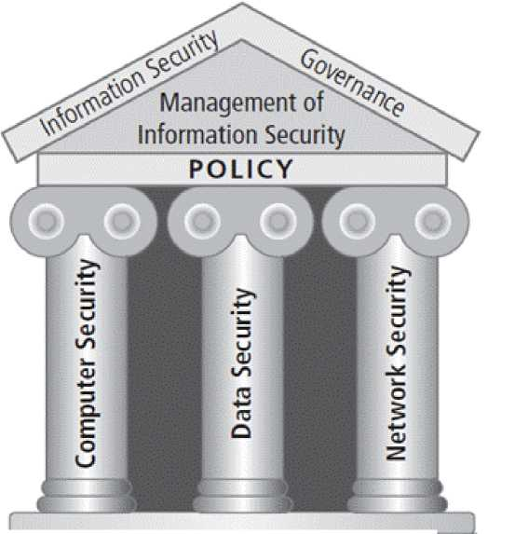
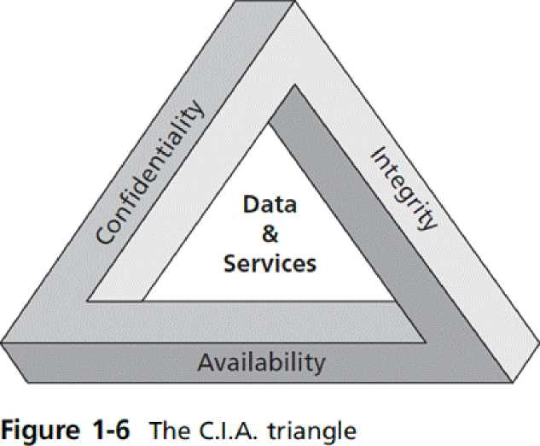
i_n
5
CvJ
CT
[—^-Confidentiality—Integrity-Availability—U
Figure 1-5 Components of information security
Principles of Information Security, Fifth Edition
7

Slide 16
Computer Security Requirements
Secrecy
Integrity
Availability
Authenticity
Non-repudiation
Access control

Slide 17
Secrecy
Secrecy requires that the information in a computer systems only be accessible for reading by authorized parties. This type of access includes printing, displaying, and other forms of disclosure, including simply revealing the existing of an object.

Slide 18
Integrity
Integrity requires that the computer system asset can be modified only by authorized parties. Modification includes writing, changing, changing status, deleting, and creating.

Slide 19
Availability
Availability requires that computer systems assets are available to authorized parties.
Availability: A "requirement intended to assure that systems work promptly and service is not denied to authorized users."

Slide 20
Authenticity
Authenticity means that parties in an information services can ascertain the identity of parties trying to access information services.

Slide 21
Non-repudiation
Originator of communications can’t deny it later
Associates the identity of the originator with the transaction in a non-deniable way

Slide 22
Access Control
Unauthorized users are kept out of the system
Unauthorized users are kept out of places on the system/disk

Slide 23
Security Requirements are often Combined
These are often combined
User authentication used for access control purposes
Non-repudiation combined with authentication

Slide 24
Type of Attacks/Threats in Computer Systems
A threat is a danger which could affect the security (confidentiality, integrity, availability) of assets, leading to a potential loss or damage.
Interruption
Interception
Modification
Fabrication

Slide 25
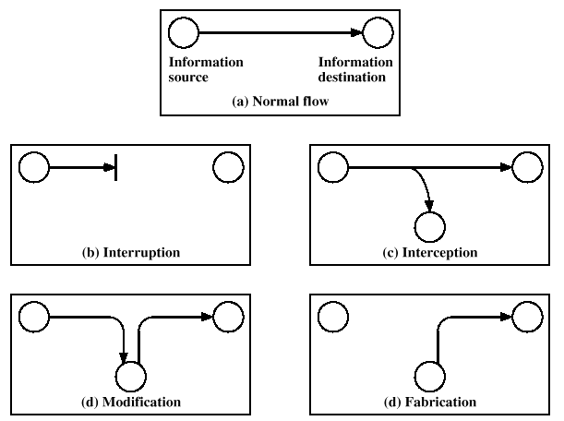
Type of Attacks in Computer Systems

Slide 26
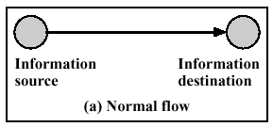
Normal Flow of Information

Slide 27
Interruption
An asset of the system is destroyed or becomes unavailable or unusable. This is an attack on the availability. Examples include destruction of a piece of hardware, such as a hard disk, the cutting of a communication link, etc.

Slide 28
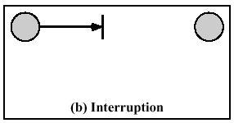
Interruption

Slide 29
Interception
Information disclosure/information leakage
An unauthorized party gains access to an asset.
This is an attack on confidentiality.
The unauthorized party could be a person, a program or a computer.
Examples include monitoring to capture data in a network and the illegal copying of files or programs.

Slide 30
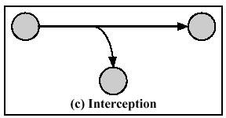
Interception

Slide 31
Modification
Integrity violation
An unauthorized party not only gains access to but tampers with an asset.
This is an attack on the integrity.
Examples include changing values in a data file, altering a program so that it performs differently and modifying the content of a message being transmitted in a network.

Slide 32
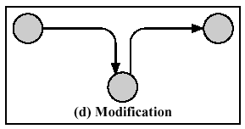
Modification

Slide 33
Fabrication
An unauthorized party inserts fake objects into the system. This is an attack on the authenticity. Examples include the insertion of false messages in a network or the addition of records to a file.

Slide 34
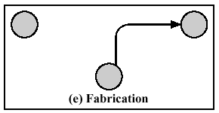
Fabrication

Slide 35
Classification of Attacks
Computer Security attacks can be classified into two broad categories:
Passive Attacks can only observe communications or data
Active Attacks can actively modify communications or data, Often difficult to perform, but very powerful
Mail forgery/modification
TCP/IP spoofing/session hijacking

Slide 36
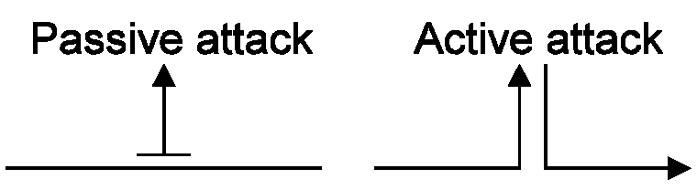
Passive Attacks and Active Attacks

Slide 37
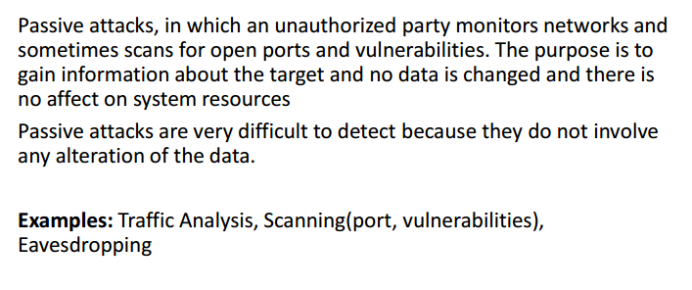
Passive Attacks

Slide 38
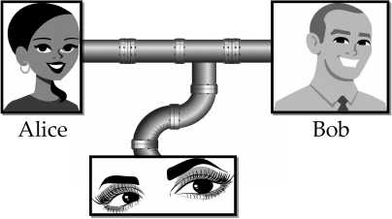
•
Eavesdropping: the interception of information
intended for someone else during its transmission over a communication channel.
Eve

Slide 39
Passive Attacks Problems
Difficult to detect because there is no modification of data
Protection approach should be based on prevention rather than detection.

Slide 40
Active Attacks
Active attacks involve some sort of modification of the data stream or the creation of a false stream. Four sub-categories:
Masquerade
Replay
Modification of Messages
Denial of service

Slide 41
Masquerade
An entity pretends to be another
For the purpose of doing some other form of attack
Example a system claims its IP address to be what it is not, IP spoofing

Slide 42
Replay
First passive capture of data and then its retransmission to produce an unauthorized effect.

Slide 43
Modification of Messages
Some portion of a legitimate message is altered or messages are delayed or reordered to produce an unauthorized effect.

Slide 44
Denial of Service
The interruption or degradation of a data service or information access.

Slide 45
Problems with Active Attacks
Easy to detect but difficult to prevent
Efforts are directed to quickly recover from disruption or delays
Good thing is that detection will have a preventive effect.

Slide 46
Security Solutions
Physical security
Encryption
Access control
Automatic call back
Node authentication
Differentiated access rights
User authentication
Passwords
Challenge-response systems
Token or smart cards
Exchange of secret protocol
Personal characteristics - Biometrics

Slide 47
Security Mechanisms
Three basic building blocks are used:
Encryption is used to provide confidentiality, can provide authentication and integrity protection
Digital signatures are used to provide authentication, integrity protection, and non-repudiation
Checksums/hash algorithms are used to provide integrity protection, can provide authentication
One or more security mechanisms are combined to provide a security service

Slide 48
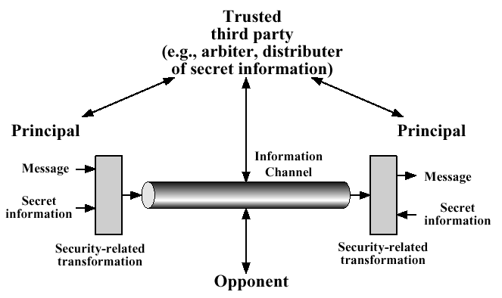
Model for Network Security

Slide 49
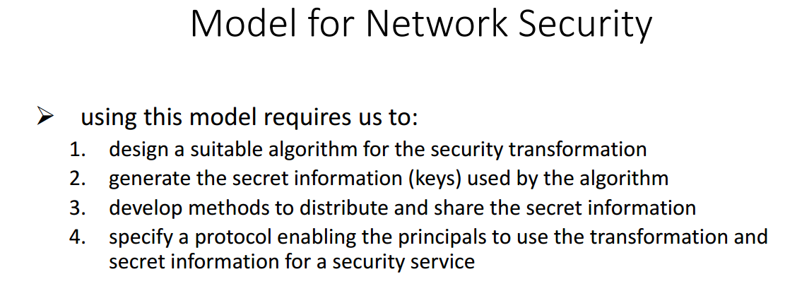

Slide 50
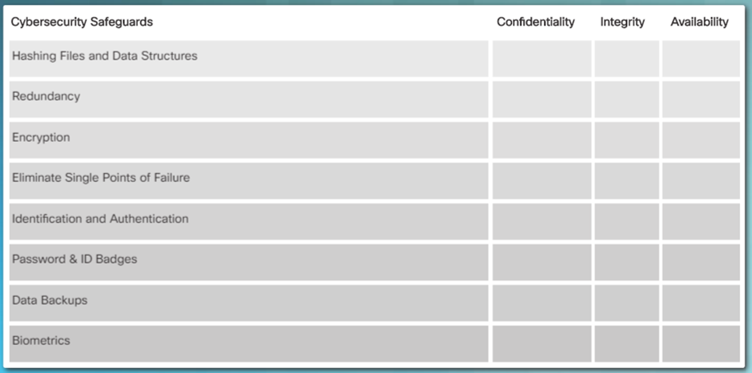
Class Activity

Slide 51
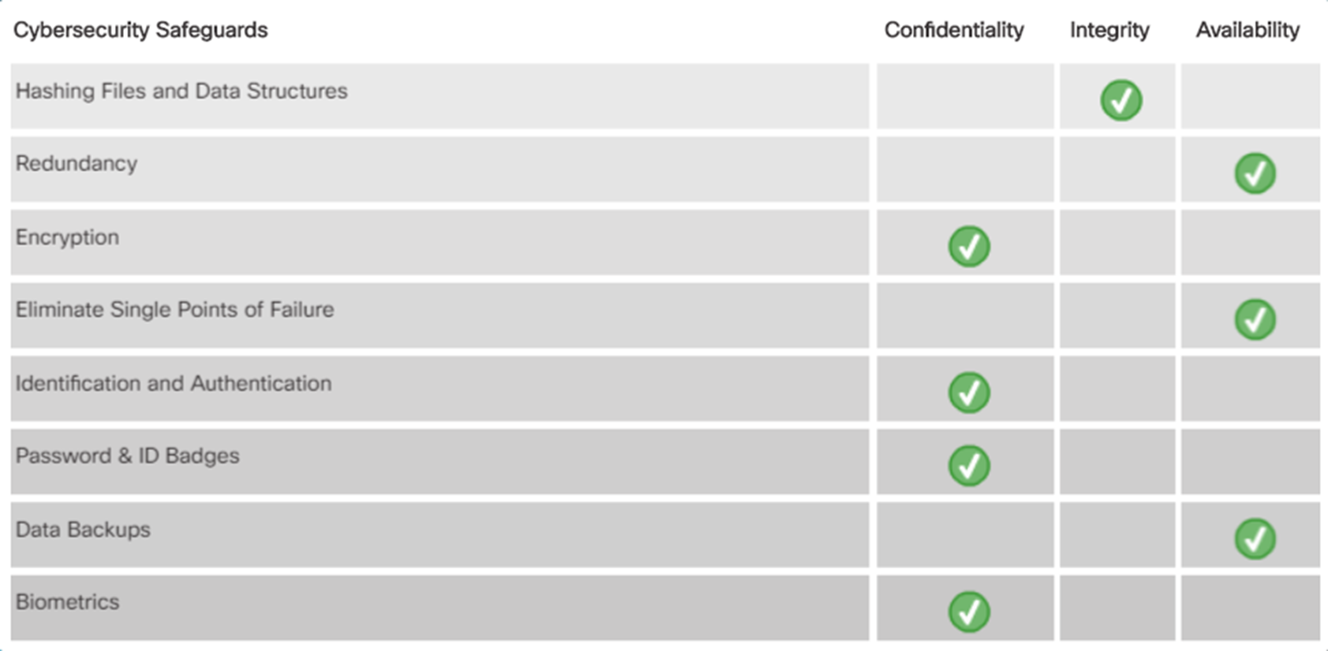
Class Activity

